Slide 1
Ads Midterm project - group 8
Prudential Insurance data mining

Slide 2
Overview
Data Preprocessing
Changing the data types
Remove columns having more than 30000 Nas
Insert missing values
Convert the factorial data
Convert columns having more than 6 categories into continuous data
Apply SVM on dataset
Apply linear regression
Apply Decision Tree Algorithms

Slide 3
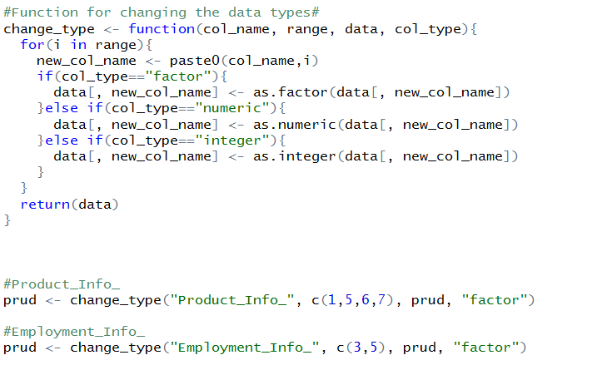
Data Pre-processing
Changing Data types
1. Created generic function for changing
Data types
When imported data, datatypes were either
Numeric or integer
3. In documentation some of the columns
having datatype as factor.

Slide 4
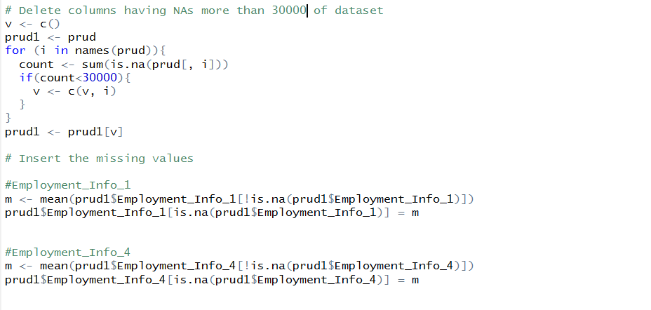
Data Pre-processing
Deleted columns having more than 30k
Blank values.
Because if we don’t omit those columns
It will be like we are predicting for more
Records from small number of training data.
3. Inserting missing values by mean.

Slide 5
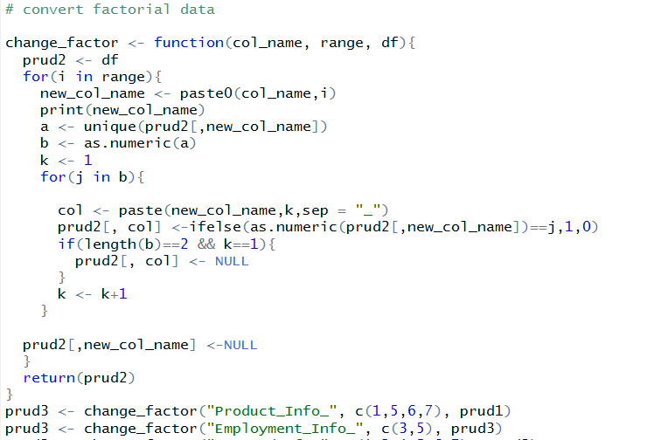
Data Pre-processing
Transform from categorical to continuous
Example, if columns has 3 factors, then
We will split that into three columns.
For 1st category- 100
For 2nd category- 010
For 3rd category- 001

Slide 6
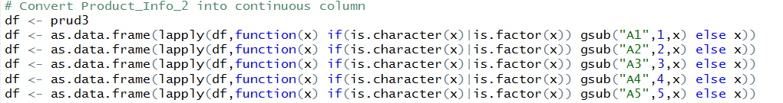
Converting to continuous data

Slide 7
Linear Regression
A new predictive model has been built with just the above significant variables.
Those columns with less p value are selected since they are significant variables
The new model has a high R-Squared value which means the model has higher predictive power
The model was applied on a test data and the results are compared
The root Mean Square error(RMSE) is evaluated to determine the model performance

Slide 8
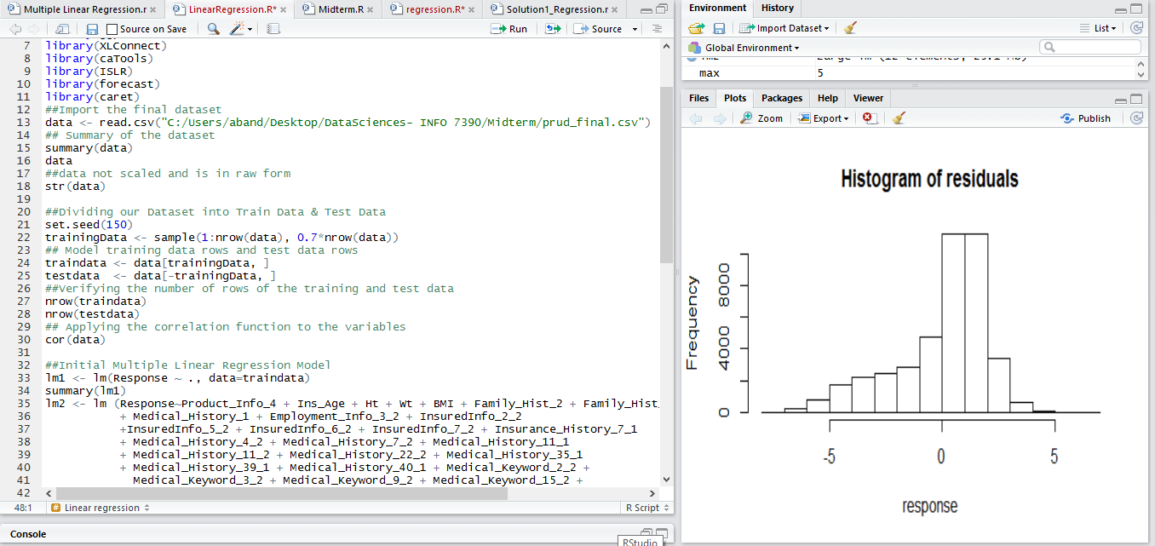
Plot Linear Regression

Slide 9
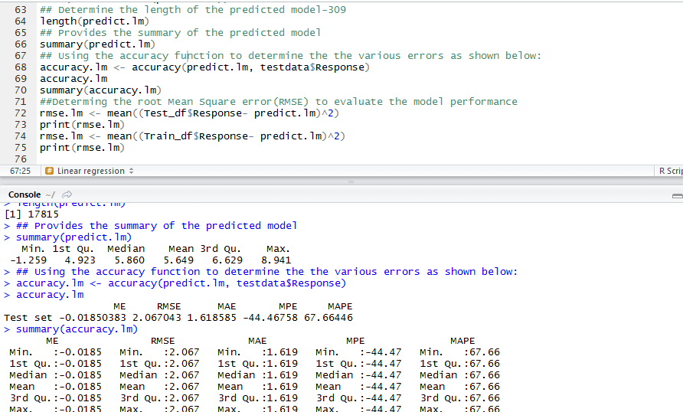
Error

Slide 10
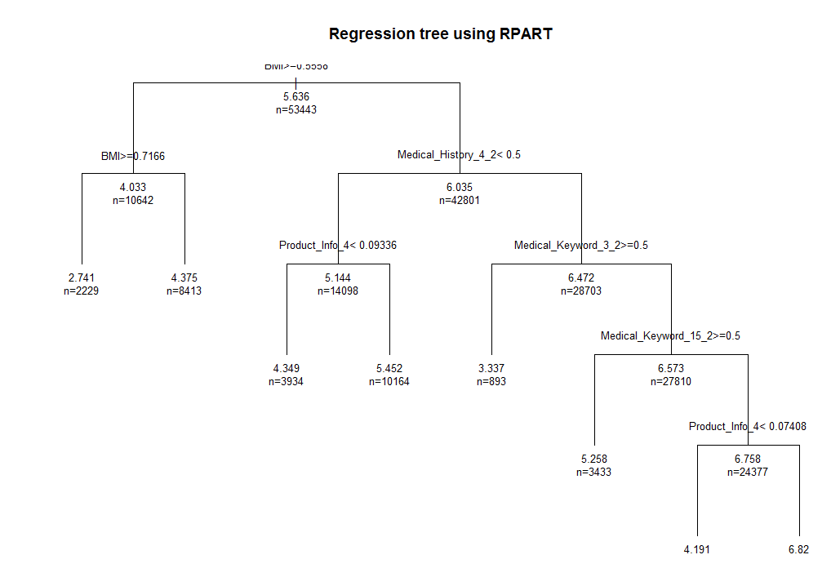
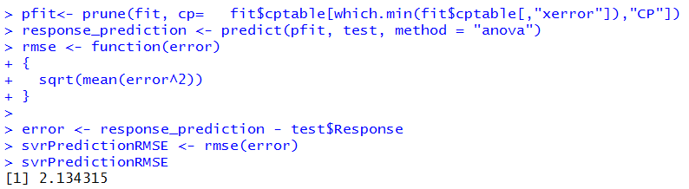
Regression decision tree – Rpart Algorithm

Slide 11
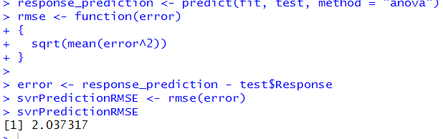
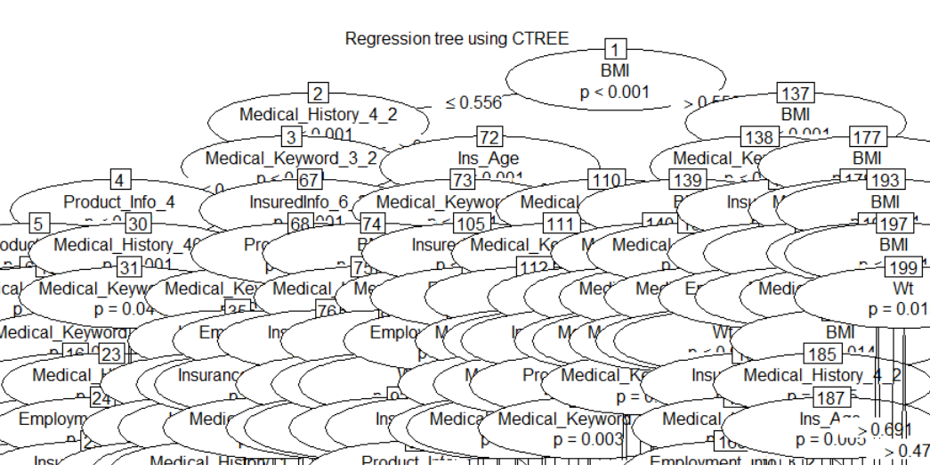
Ctree algorithm

Slide 12
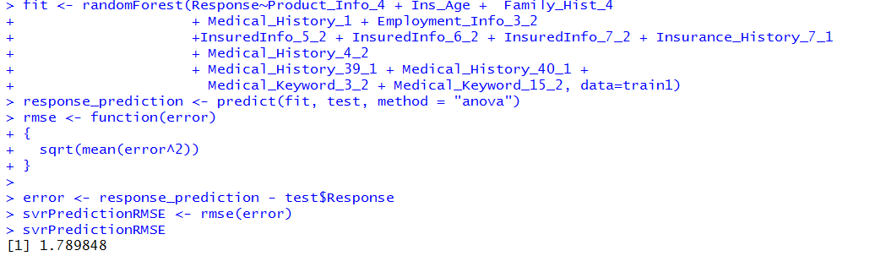
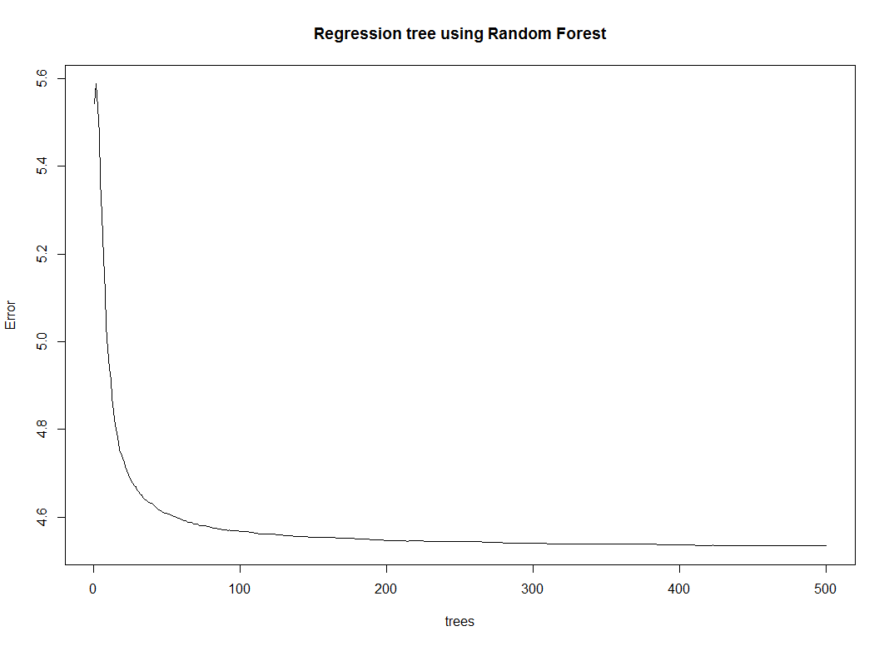
Random forest # Best decision tree

Slide 13
SVM
Extract 2000 rows from the data (because tuning is very time consuming)
Apply SVM function on the training data set:
Package e1071
Function svm()
Tuning the model
Function tune.svm()
Try gamma from 0.01 to 1, cost from 1 to 100
Run the algorithm again with the optimal parameters

Slide 14
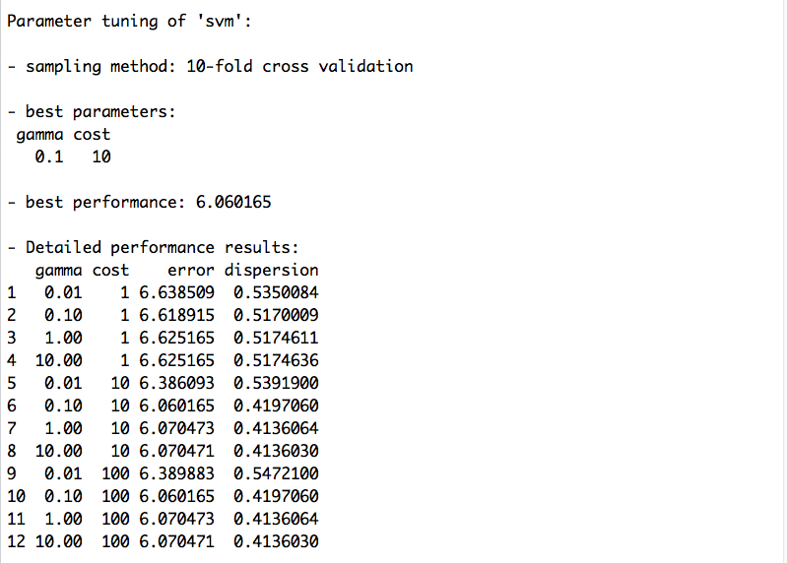
Tuning result

Slide 15
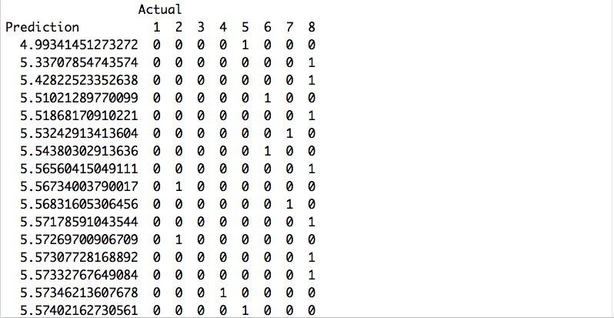

Prediction vs. actual values

Slide 16
Thank You !
***Disclaimer: Any Question ?

